Slide 1




gRPC:
A multi-platform RPC system
Google confidential │ Do not distribute
Google confidential │ Do not distribute

Slide 2
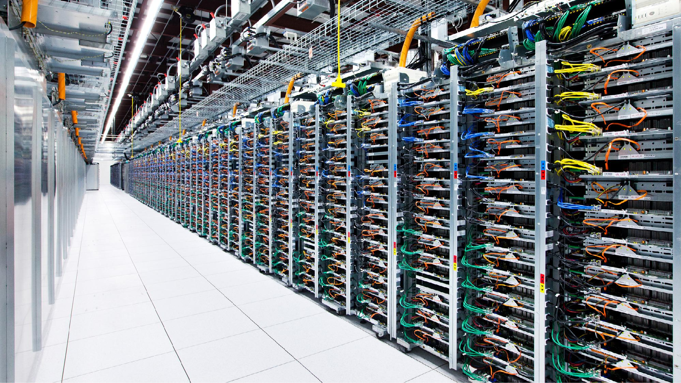
Microservices at Google
~O(10¹⁰) RPCs per second.
Google confidential │ Do not distribute
Images by Connie Zhou

Slide 3
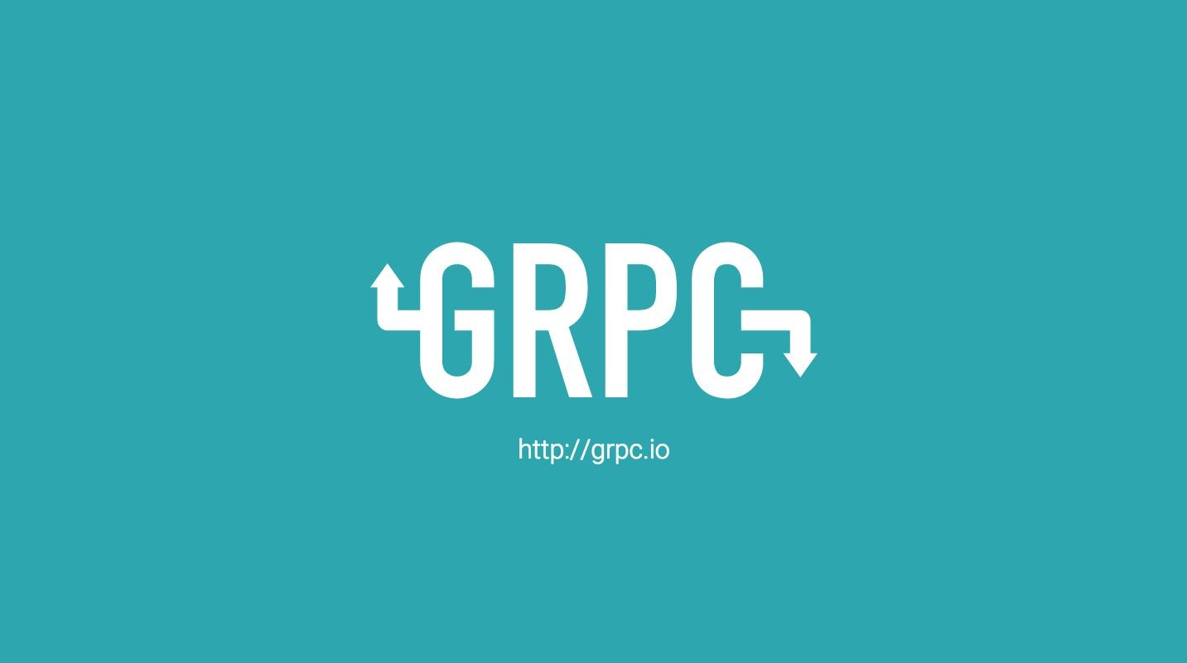


gRPC core
gRPC java
Open source on Github for C, C++, Java, Node.js, Python, Ruby, Go, C#, PHP, Objective-C

Slide 4

OVERVIEW

Slide 5

gRPC is ...
Open Source RPC framework that makes it easy to build a heterogenous distributed system.
Free as in beer! (and licensing)
Based on HTTP/2 today (multiplexed, works with the Internet)
Payload agnostic (we’ve implemented proto)
Streaming & Flow-Controlled
Designed for harsh environments (timeout, lameducking, load-balancing, cancellation, …)
Support in 10 languages & first class mobile support
Layered & Pluggable - Bring your own monitoring, auth, naming, load balancing ...

Slide 6
Project Status
Core features and protocol are fully specified
Rolled out for public Google APIs and widely used internally
Lots of mobile adoption
Approaching 1.0 (GA) release in all languages
Stable APIs for key features
Benefit of layering on top of HTTP/2 standard
Interoperability with 3rd party proxies, tools, libraries..
WHATWG Fetch

Slide 7





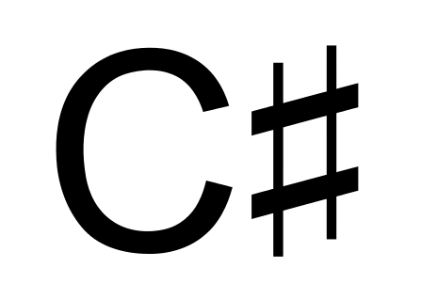


C/C++
Multiple Languages

Slide 8

HTTP/1.1
http://www.http2demo.io/
HTTP/2

Slide 9
Protocol Buffers
IDL (Interface definition language) Describe once and generate interfaces for any language.
Data Model
Structure of the request and response.
Wire Format
Binary format for network transmission.
message SubscribeRequest { string topic = 1;
}
message Event { string details = 1;
}
service Topics {
rpc Subscribe(SubscribeRequest) returns (stream Event);
}

Slide 10
Implementation Details
Three complete stacks: C/C++, Java and Go.
Other language implementations wrap C-Runtime libraries.
Hand-written wrappers to maintain language idioms
Why wrap C?
Development costs & Implementation Consistency
Performance
Feature evolution
Easy one line installation via packages e.g npm install grpc

Slide 11
USE CASES

Slide 12
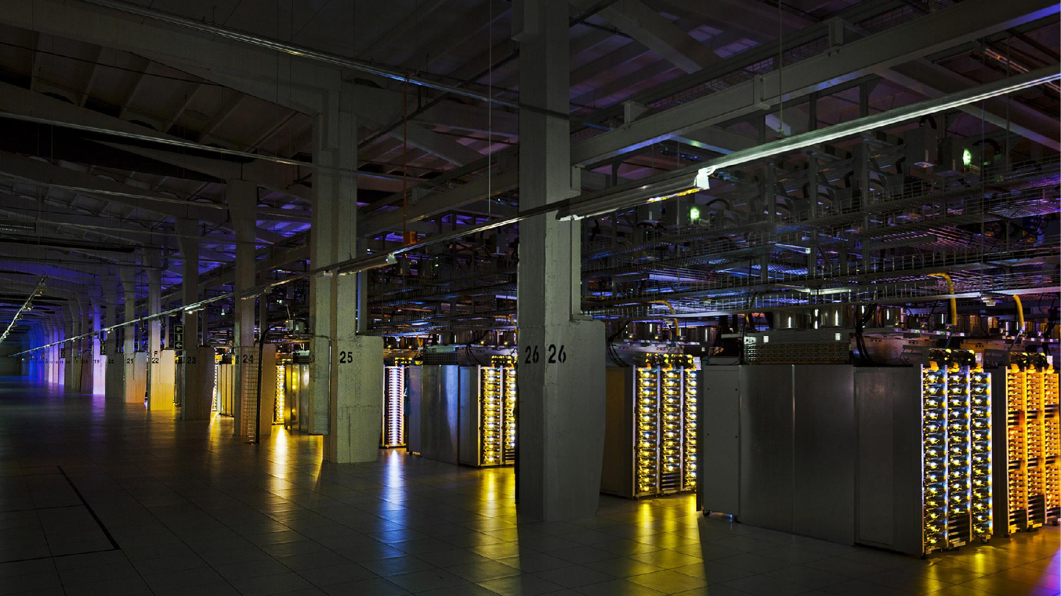
Use Cases
Build distributed applications
In data-centers
In public/private cloud
Client-server communication
Clients and servers across:
Mobile
Web
Cloud
Also
Embedded systems, IoT
Access Google Cloud Services
From GCP
From Android and iOS devices
From everywhere else
Google confidential │ Do not distribute
Images by Connie Zhou

Slide 13
HOW TO GET STARTED

Slide 14
Typical development workflow
Install
apt-get install protobuf-compiler
pip install grpcio
Write the protos
Use protoc to generate service interfaces, messages & stubs
Implement services in server
Client instantiates stub
Test & Deploy

Slide 15
Advanced Deployment...
Auth & Security - TLS [Mutual], Plugin auth mechanism (e.g. OAuth)
Proxies - nghttp2, haproxy, Google LB, Nginx (in progress)
Client-side load balancing - etcd, Zookeeper, Eureka, …
Monitor & Trace - Zipkin, Google, DIY
Mobile - Reconnect, QUIC
Web - REST Adapter, WHATWG Fetch
API Evolution - Protobuf, Versioning

Slide 16
ARCHITECTURE

Slide 17
Architecture: Native Implementation in Language
Code Generated API
gRPC Core
Http 2.0
SSL
Planned in: C/C++, Java, Go
Application Layer
Framework Layer
Transport Layer

Slide 18
Architecture: Derived Stack
Code-Generated Language Idiomatic API
Code Generated
Python | Ruby | PHP | Obj-C, C#, C++, ...
Python | Ruby | PHP | Obj-C, C#, C++,...
Generic Low Level API in C
gRPC Core in C
Http 2.0
SSL
Language Bindings
Application Layer
Framework Layer
Transport Layer

Slide 19
Auth Architecture and API
Code Generated API
gRPC Core
Http 2.0
SSL
 | Credentials API
Auth-Credentials Implementation |  |  | Auth Plugin API

Slide 20
Metadata and Auth
Generic mechanism for attaching metadata to requests and responses
Built into the gRPC protocol - always available
Plugin API to attach “bearer tokens” to requests for Auth
OAuth2 access tokens
OIDC Id Tokens
Session state for specific Auth mechanisms is encapsulated in an Auth- credentials object

Slide 21
ADVANCED FEATURES

Slide 22
gRPC: Naming
server
s
client
name
nameserver
addresses, ...

Slide 23
gRPC: LoadBalancing
server
s
client
Control RPC
LB
Controller
address-list

Slide 24
Roadmap: Timeline
Additional Alpha Releases
Beta Release
Stability, Easy installation,
1.0 release
Load balancing, Naming, Performance
Debugging and Tracing, Browser support
Initial Alpha Release
Q1 ‘15
Q2 ‘15
Q3 ‘15, Q4’15
Q1 ‘16
Q2 ‘16
Q3 16

Slide 25

Motivation for RPC systems
Large-scale distributed systems actually composed of microservices
Allows loosely-coupled and even multilingual development
Scalability: things, cores, devices, nodes, clusters, and data centers (DCs)
Communication predominantly structured as RPCs
Many models of RPC communication
Terminology: Client uses a stub to call a method running on a service/server
Easiest interfaces (synchronous, unary) resemble local procedure calls translated to network activity by code generator and RPC library
High-performance interfaces (async, streaming) look like Active Messaging
Long way from textbook description of RPCs!

Slide 26
Application composed of microservices
Monitoring Task
Server
Server
Stub
Stub
Server
Computation Task
Stub
UI Task
Data Store Task

Slide 27
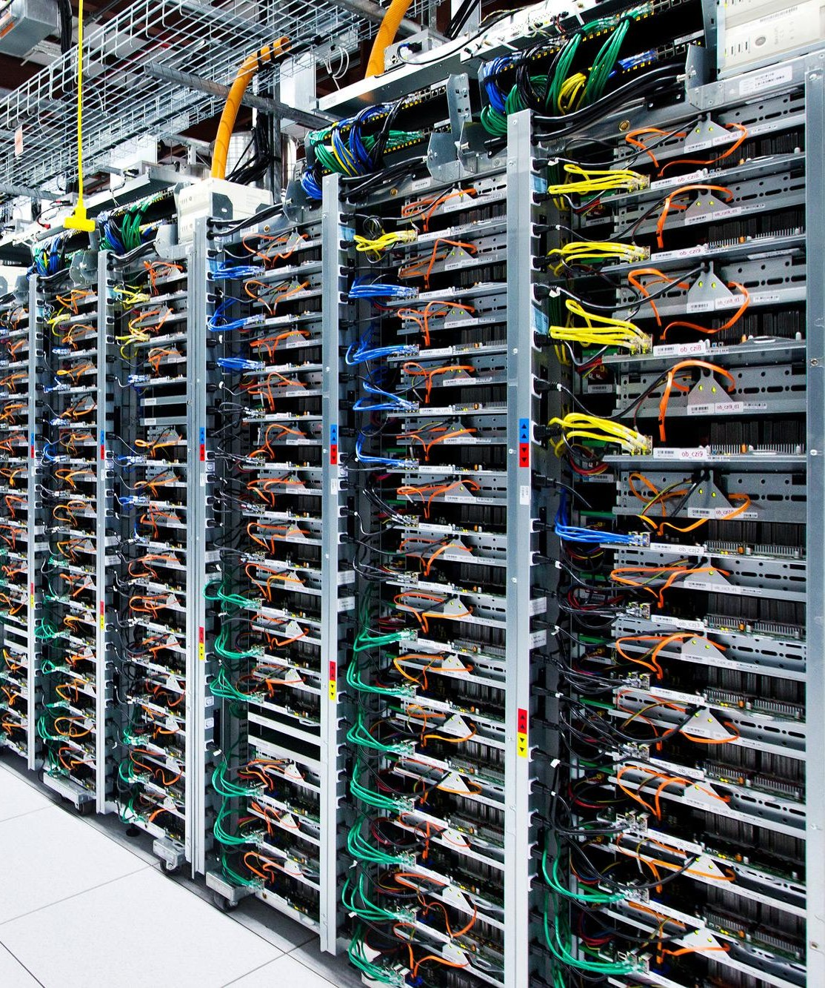
gRPC: Motivation
Google has had 4 generations of internal RPC systems, called Stubby
All production applications and systems built using RPCs
Over 10¹⁰ RPCs per second, fleetwide
APIs for C++, Java, Python, Go
Not suitable for open-source community! (Tight coupling with internal tools)
Apply scalability, performance, and API lessons to external open-source

Slide 28
gRPC: Summary
Multi-language, multi-platform framework
Native implementations in C, Java, and Go
C stack wrapped by C++, C#, Node, ObjC, Python, Ruby, PHP
Platforms supported: Linux, Android, iOS, MacOS, Windows
This talk: focus on C++ API and implementation (designed for performance)
Transport over HTTP/2 + TLS
Leverage existing network protocols and infrastructure
Efficient use of TCP - 1 connection shared across concurrent framed streams
Native support for secure bidirectional streaming
C/C++ implementation goals
High throughput and scalability, low latency
Minimal external dependencies

Slide 29


Using HTTP/2 as a transport

Slide 30
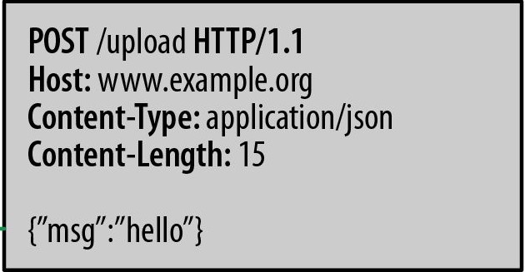
Using an HTTP transport: Why and How
Network infrastructure well-designed to support HTTP
Firewalls, load balancers, encryption, authentication, compression, ...
Basic idea: treat RPCs as references to HTTP objects
Encode request method name as URI
Encode request parameters as content
Encode return value in HTTP response

Slide 31
Using an HTTP/1.1 transport and its limitations
Request-Response protocol
Each connection supports pipelining
… but not parallelism (in-order only)
Need multiple connections per client-server pair to avoid in-order stalls across multiple requests → multiple CPU-intensive TLS handshakes, higher memory footprint
Content may be compressed
… but headers are text format
Naturally supports single-direction streaming
… but not bidirectional

Slide 32
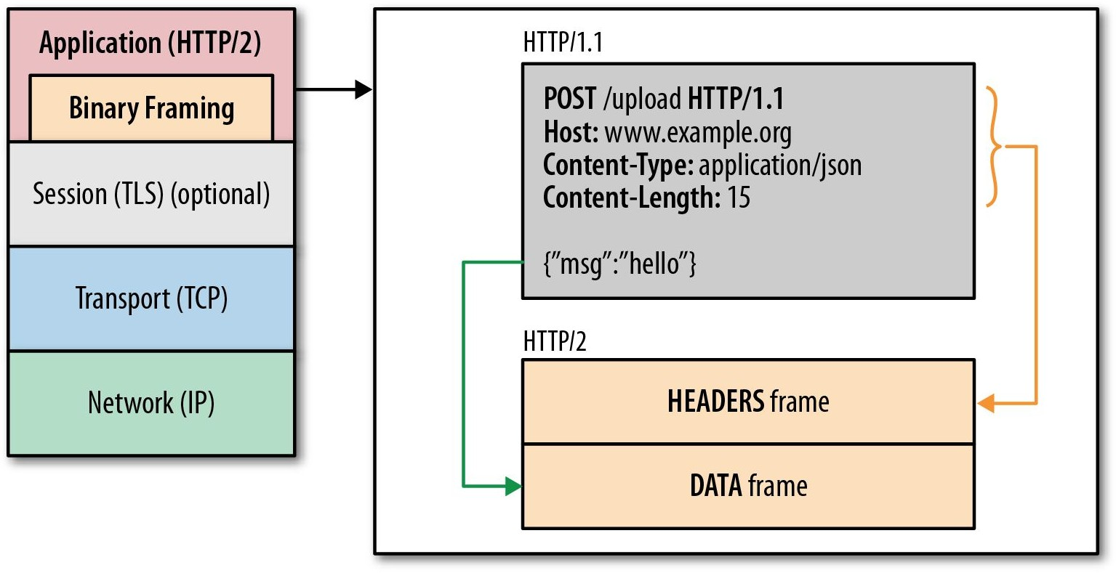
HTTP/2 in a Nutshell
One TCP connection for each client-server pair
Request → Stream
Streams are multiplexed using framing
Compact binary framing layer
Prioritization
Flow control
Server push
Header compression
Directly supports bidirectional streaming

Slide 33
HTTP/1.1
http://www.http2demo.io/
HTTP/2

Slide 34
gRPC

Slide 35

gRPC in a nutshell
IDL to describe service API
Automatically generates client stubs and abstract server classes in 10+ languages
Takes advantage of feature set of HTTP/2

Slide 36
An Aside: Protocol Buffers
syntax = “proto3”;
message Person { string name = 1; int32 id = 2; string email = 3;
enum PhoneType { MOBILE = 0;
HOME = 1;
WORK = 2;
}
message PhoneNumber { string number = 1; PhoneType type = 2;
}
repeated PhoneNumber phone = 4;
}
Google’s Lingua Franca for serializing data: RPCs and storage
Binary data representation
Structures can be extended and maintain backward compatibility
Code generators for many languages
Strongly typed
Not required for gRPC, but very handy

Slide 37
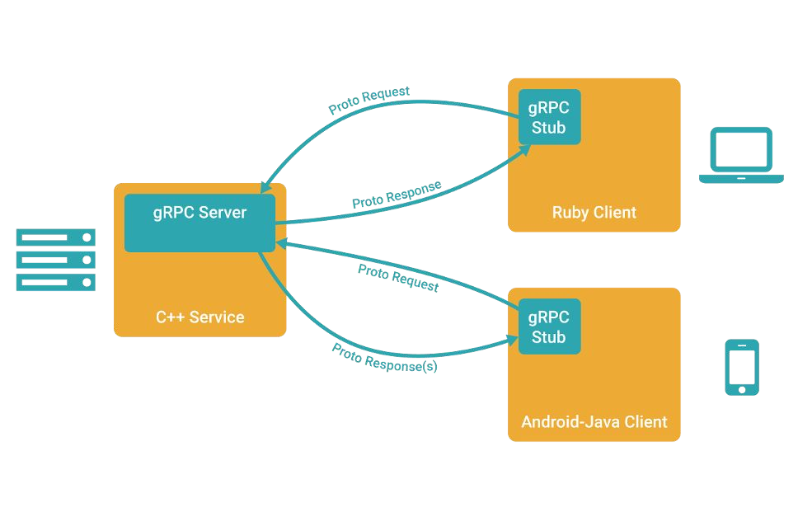
Example gRPC client/server architecture

Slide 38
Getting Started
Define a service in a .proto file using Protocol Buffers IDL
Generate server and client stub code using the protocol buffer compiler
Extend the generated server class in your language to fill in the logic of your service
Invoke it using the generated client stubs

Slide 39
Example Service Definition
service RouteGuide {
rpc GetFeature(Point) returns (Feature);
rpc RouteChat(stream RouteNote) returns (stream RouteNote);
}
message Point {
int32 Latitude = 1; int32 Longitude = 2;
}
message Feature { string name = 1; Point location = 2;
}
message RouteNote { Point location = 1; string message = 2;
}

Slide 40
An (anonymized) case study
Service needs to support bidirectional streaming with clients
Attempt 1: Directly use TCP sockets
Functional in production data center, but not on Internet (firewalls, etc)
Programmer responsible for all network management and data transfer
Attempt 2: JSON-based RPC over two HTTP/1.1 connections
Start two: one for request streaming and one for response streaming
But they might end up load-balanced to different back-end servers, so the backing servers require shared state
Can only support 1 streaming RPC at a time for a client-server pair
Attempt 3: gRPC
Natural fit

Slide 41
Authentication
SSL/TLS
gRPC has SSL/TLS integration and promotes the use of SSL/TLS to authenticate the server, and encrypt all the data exchanged between the client and the server.
Optional mechanisms are available for clients to provide certificates to accomplish mutual authentication.
OAuth 2.0
gRPC provides a generic mechanism to attach metadata to requests and responses. Can be used to attach OAuth 2.0 Access Tokens to RPCs being made at a client.

Slide 42
Wrap-up

